Slide 1

AI Helps Solve Crime
SEZAN MAHMOOD
2025/11/25

Slide 2



01
Introduction
02
What AI Can Do
03
Humans Judgment
04
Wrap-Up

Slide 3
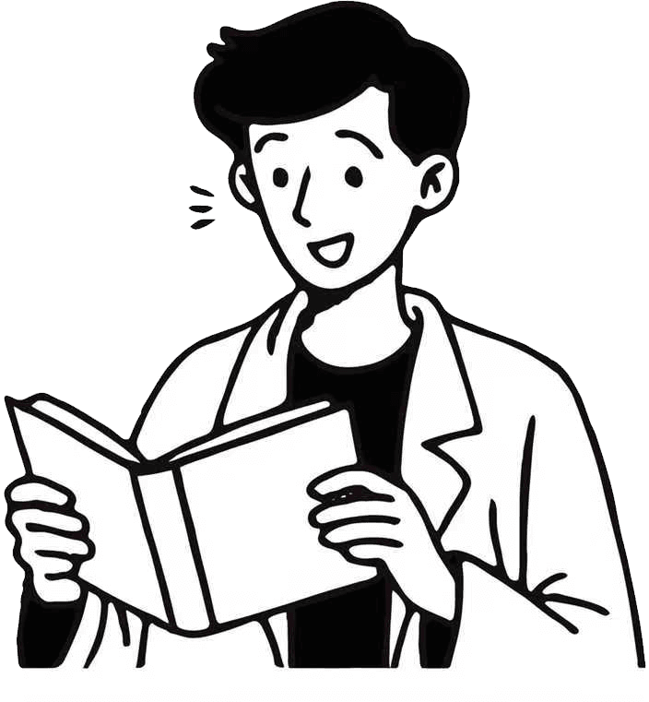
PART 01
Introduction

Slide 4


AI in Crime Fighting
New Technology in Policing
Today, police face mountains of data and evidence. AI helps them work faster and smarter. It’s like giving detectives a superpower to see patterns and connections that humans might miss.
Changing Detective Work
AI is changing how detectives work. It’s not just about finding clues faster; it’s about using new tools to solve crimes more efficiently. This technology is making detective work more effective.

Slide 5
PART 02
What AI Can Do

Slide 6
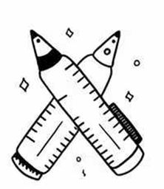


Finding Clues Faster
01
Quick Comparisons
AI can compare fingerprints or shoe marks to databases in seconds. This means police don’t have to spend hours looking at photos. It speeds up finding clues.
02
Pattern Recognition
AI is great at finding patterns. It can spot things that humans might miss, making investigations more accurate. This helps solve crimes faster.
03
Real-Time Insights
With AI, police get real-time information. This means they can act quickly based on the latest data. It’s like having a smart assistant that updates them instantly.

Slide 7
PART 03
Humans Judgment

Slide 8
AI Supports, Not Replaces
1
2
Human Judgment is Key
Enhancing Human Abilities
AI is a helper, not a replacement for human detectives. It can speed up work and find patterns, but humans still make the final decisions. AI supports police work but can’t solve crimes alone.
AI enhances human abilities by providing quick insights and data analysis. It’s a tool that helps detectives work better, but their experience and judgment are still essential.

Slide 9
PART 04
Wrap-Up

Slide 10

Smart Tools, Safer World
Powerful Crime-Fighting Tool
AI is a powerful tool in solving crimes. It helps police work faster and smarter, making our world safer. With careful use, AI can be a game-changer.
Balancing Technology and Humanity
Using AI in crime solving means balancing technology with human judgment. It’s about making our world safer without losing the human touch.

Slide 11
THANKS!
SEZAN MAHMOOD
2025/11/25

